Slide 1
Beant College
Of
Engineering & Technology
AMNINDER SINGH
6130302100 (105/06)
Computer Science Engineering

Slide 2
Media Player
Using Java Technology

Slide 3
What’s Java?
Typical Use
Source code
Compiler
Java Technologies:
Java language
Virtual machine (VM)/class file format
Libraries
Can use only VM or language
Developed by Sun
Not related to “Javascript”
Developer
Class files
User
Libraries
Virtual Machine

Slide 4
Java Modes of Use
Applets: Auto-run when view web page
Applications: Traditional program
Beans: Component (like OLE object)
Servlets: Server-side applications
Third Party APIs:- for creating Media Player
JavaMP3(1.0) & JMF2 (java media frame work)

Slide 5
Java Virtual Machine (JVM) and Class File Format
VM executes class files (inc. collections of them)
By interpretation, run-time compilation, or combination; performance is a significant issue
Before execution, VM usually runs “bytecode verifier” to check legality of class file

Slide 6
Java Libraries
Set of built-in APIs, including:
GUIs
Networking
Computation
Several classes are security-related
This presentation will skim ordinary crypto functions such as ones for encryption/decryption, certificate management, etc., since they are not essentially unique

Slide 7
Class and Method Access Control Modifiers

Slide 8
What Is JMF?
A method for working with time-based data in Java
Acquisition, processing and delivery of media
Handles real-time or stored audio and video

Slide 9
MP3 File
Structure

Slide 10
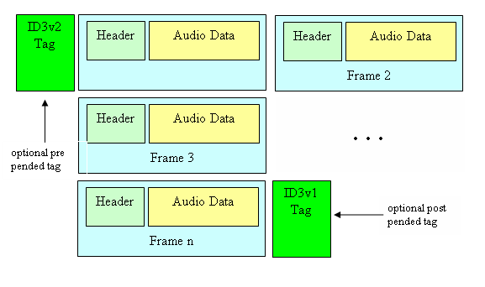
MP3 File Structure

Slide 11
Why MP3?
It is currently one of the most popular music encodings.
Potential users of karaoke software are most likely to pick the mp3 format above any other audio encoding on the market.
MP3 is an open standard which means that it is well documented and accessible.
Choosing a proprietary, closed format such as Windows Media Audio (WMA) could put the researchers in legal jeopardy.

Slide 12
Java & MP3
Java provides a low-level API for effecting and controlling the input and output of sound media.
More advanced features can be found in external libraries created by the Java community. One example of such library set is the Java Media Framework (JMF).

Slide 13
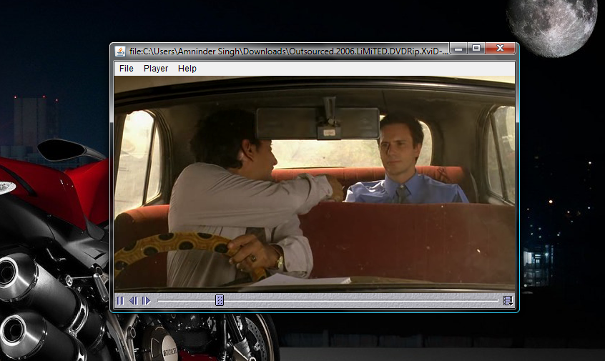
Video stream of JMF

Slide 14


Audio Stream Playback

Slide 15
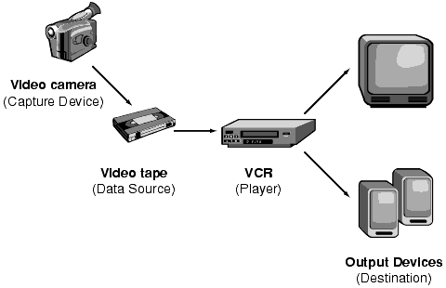
Structure Explanation

Slide 16
Player
Player object allows easy embedding of content
Create widget and catch realization events
Heavy-weight widget

Slide 17
Player [cont’d]
public void init() {
setLayout( new BorderLayout() );
String mediaFile = getParameter( "FILE" );
try {
URL mediaURL = new URL( getDocumentBase(), mediaFile );
player = Manager.createPlayer( mediaURL );
player.addControllerListener( this );
}
catch (Exception e) {
System.err.println( "Got exception " + e );
}
}

Slide 18
Plugins
Plugins can be dynamically loaded in system
Add functionality to the system
Codecs, Effects, Mux, Demux, Renderers
Media handlers
Plugin
Codec
Demux
Mux
VideoRenderer
Renderer
Effect

Slide 19
Codecs
Codec interface extends Plugin
Codecs have input and output, modifying the content
Codec A
Codec B
Data 1
Format A
Data 2
Format B
Data 3
Format C

Slide 20
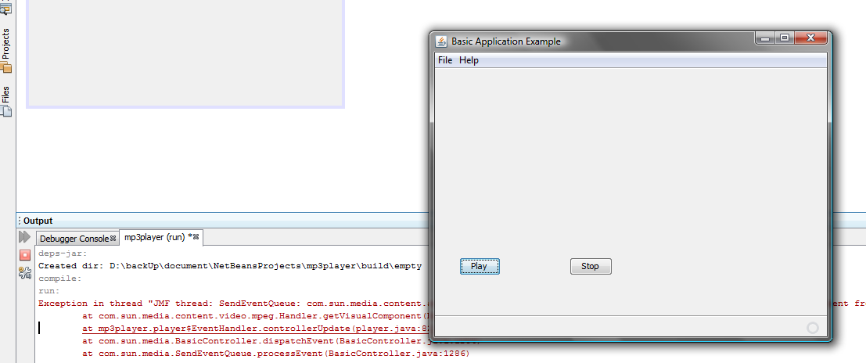
Screen Shot of play & Stop Module window

Slide 21
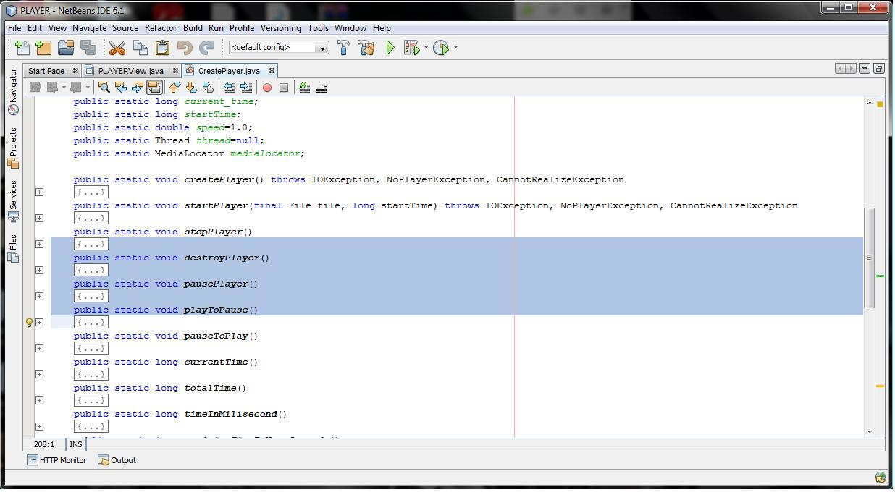
CREATE PLAYER

Slide 22
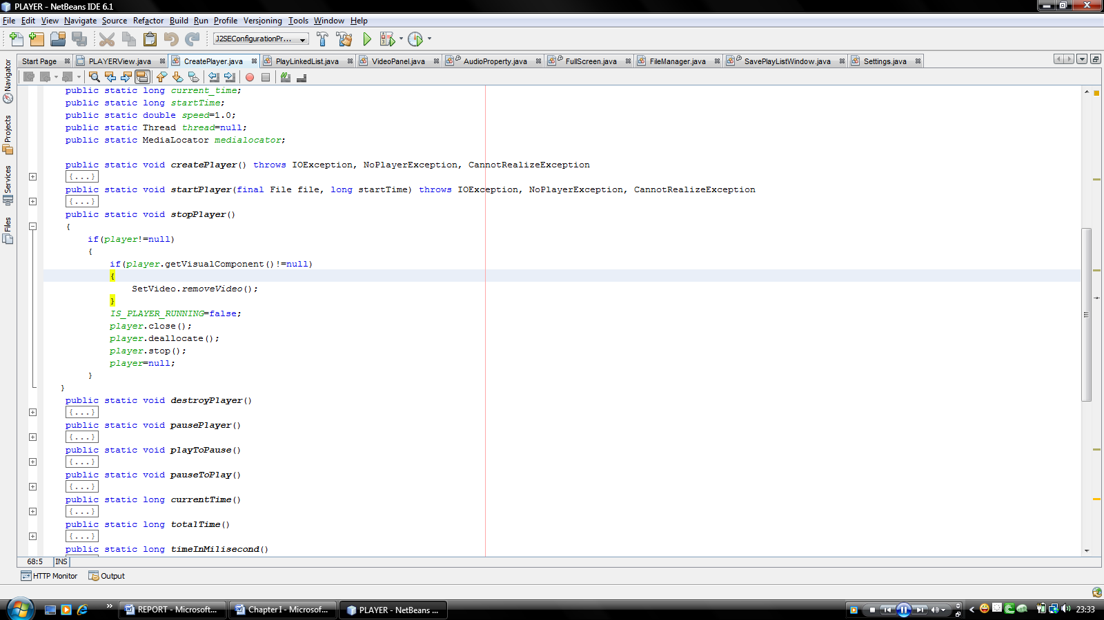
STOP PLAYER

Slide 23
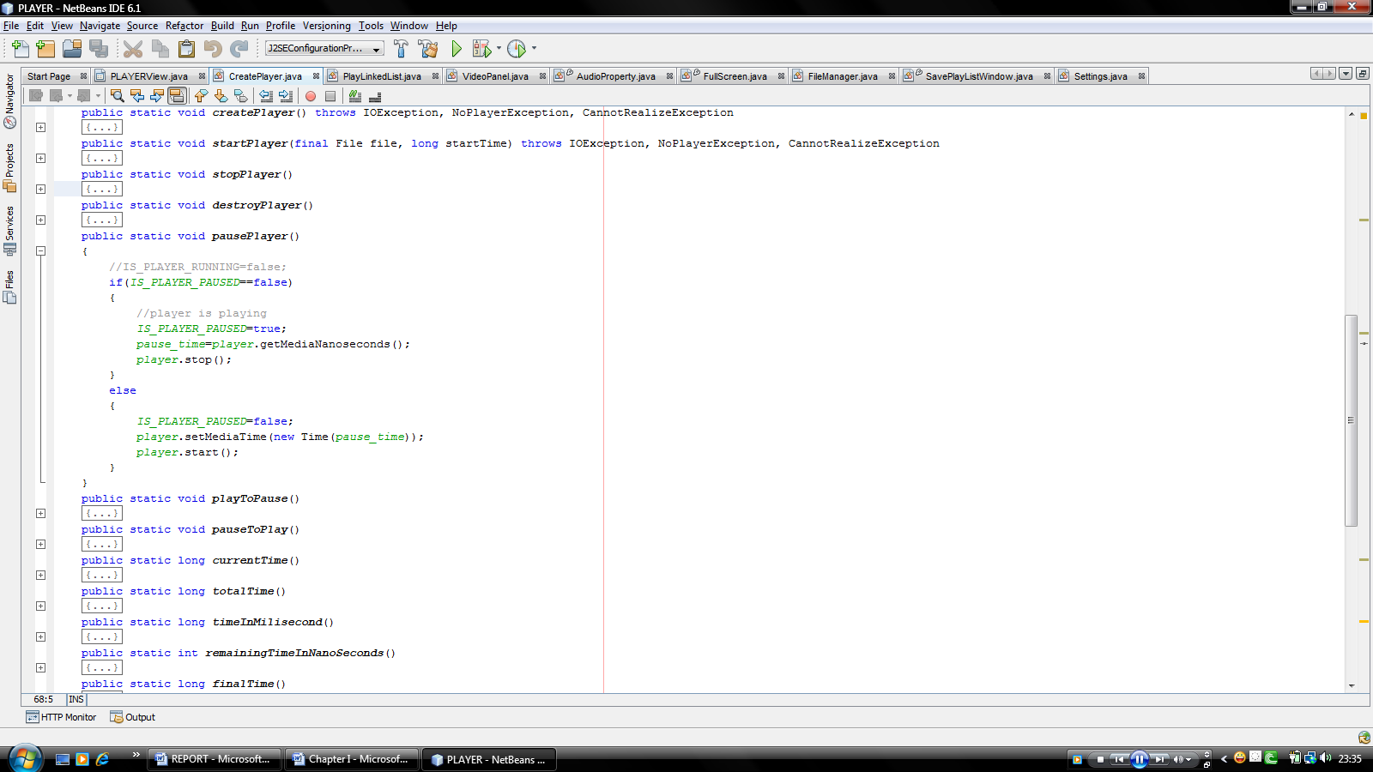
Pause Player

Slide 24
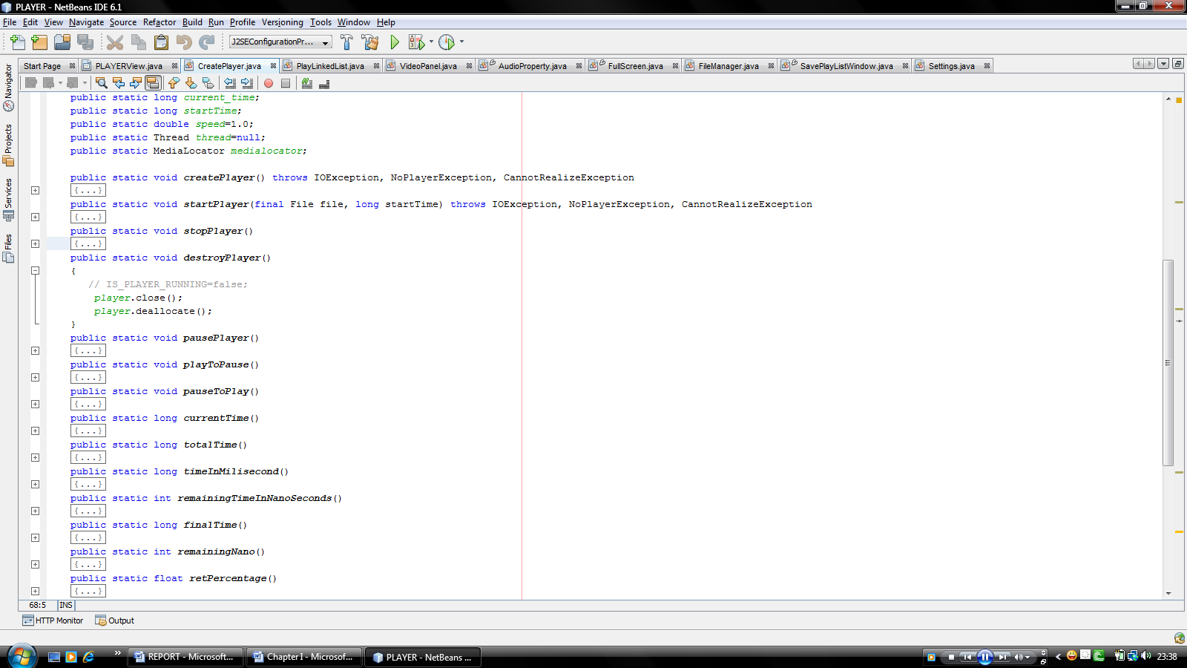
Destroy Player

Slide 25
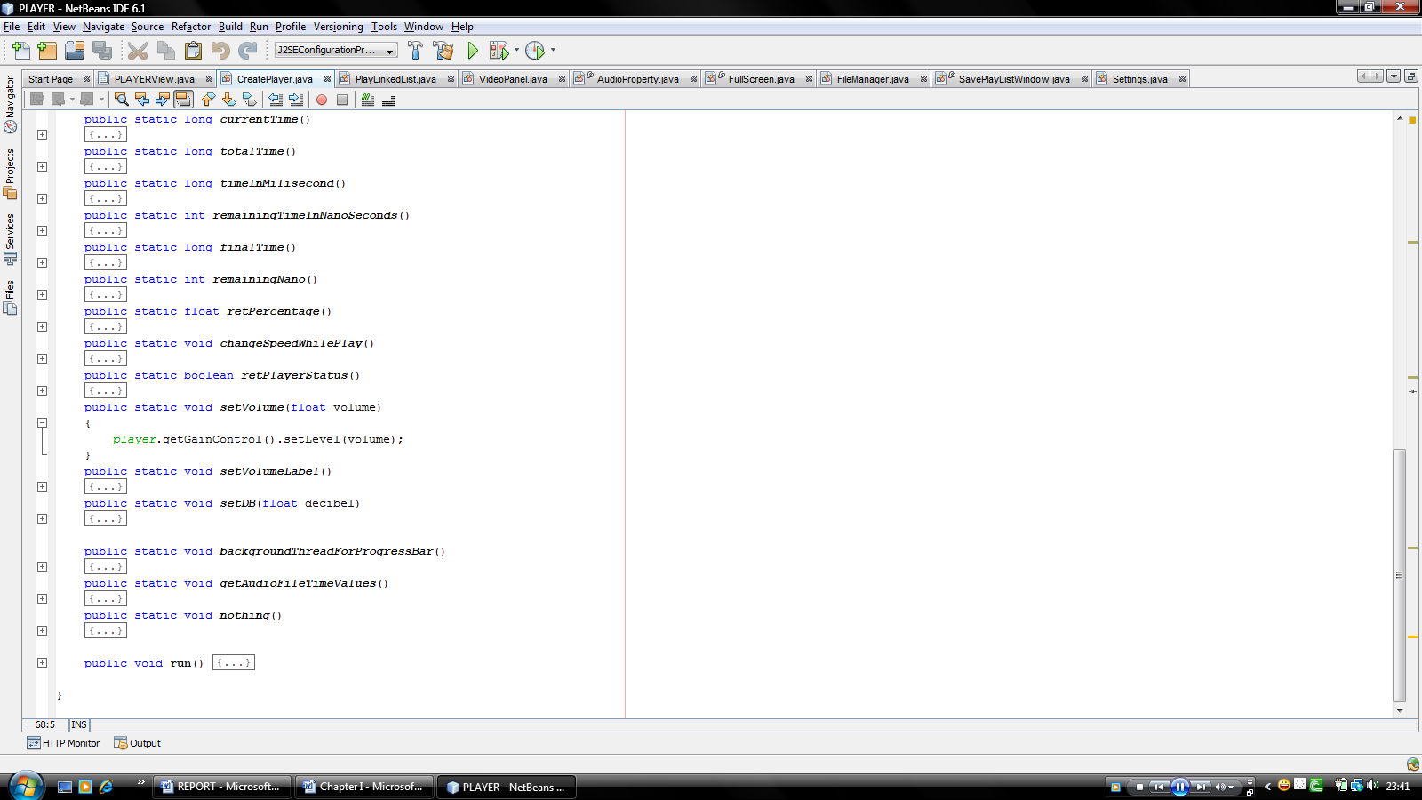
Setting Gain-Control Value

Slide 26
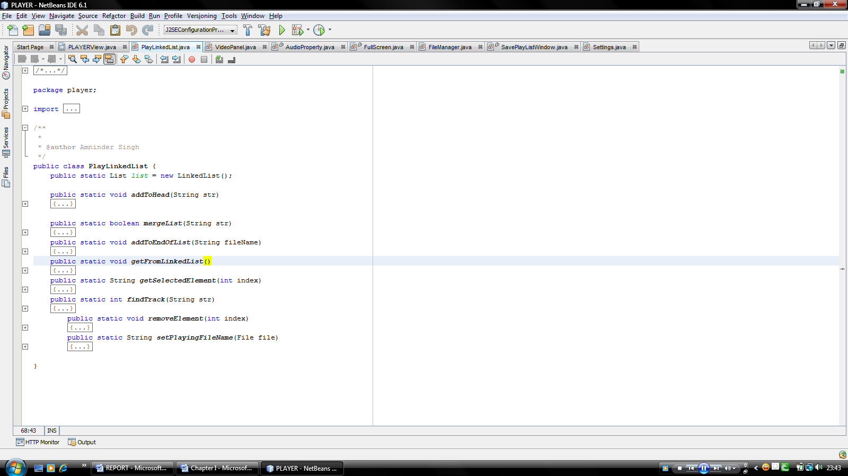
Playlist using LINKED LIST

Slide 27
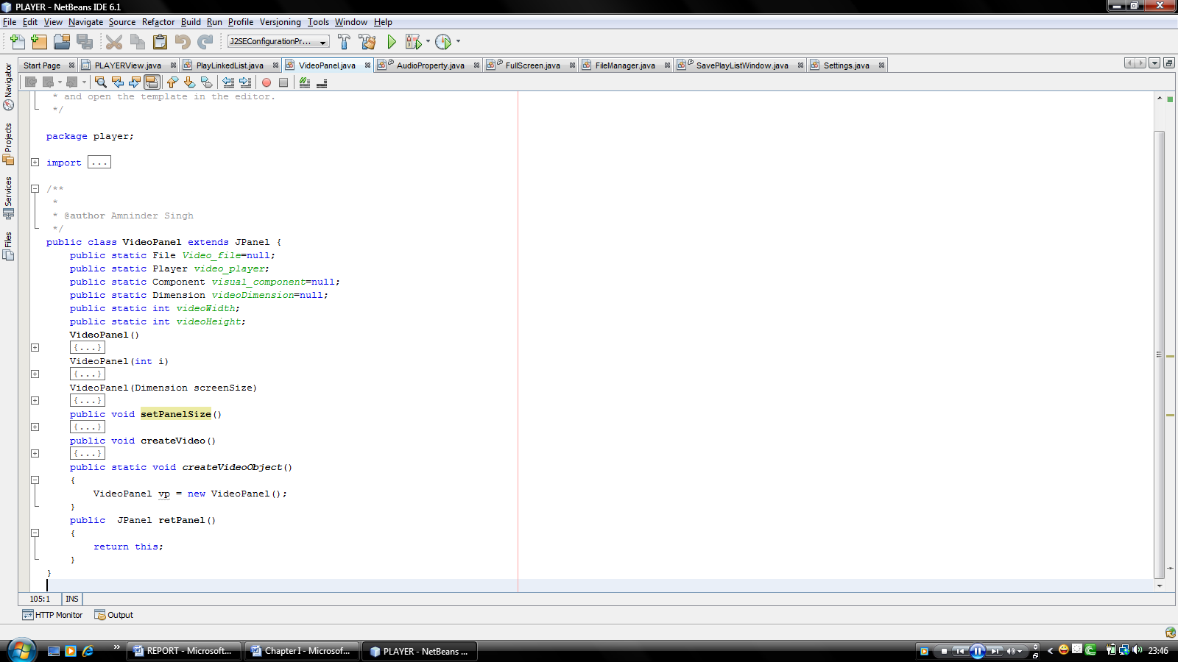
Video Panel

Slide 28
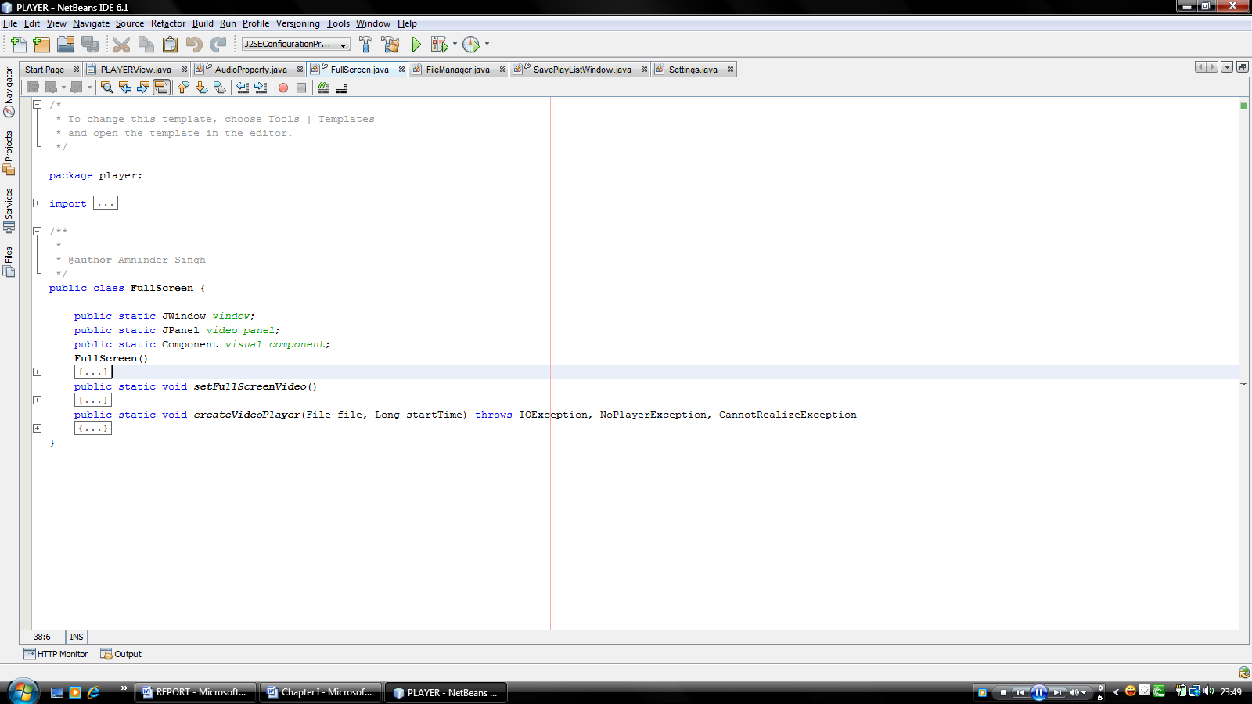
Full Screen

Slide 29
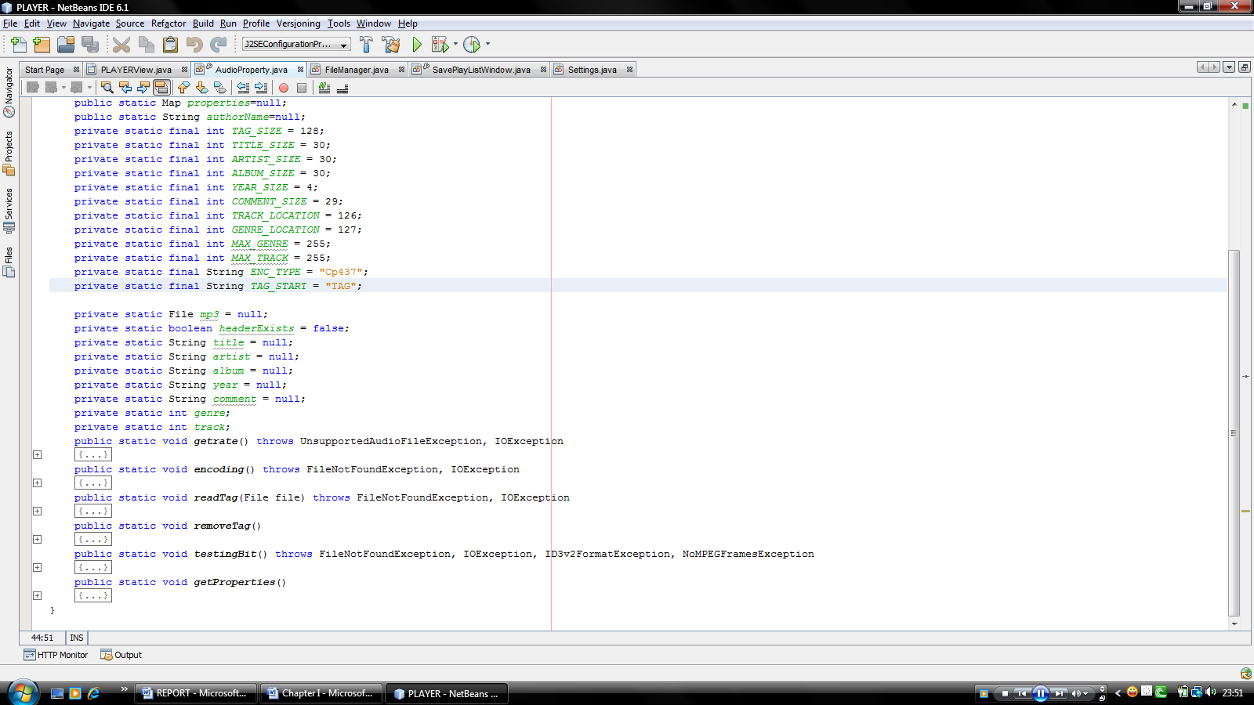
Audio Property

Slide 30
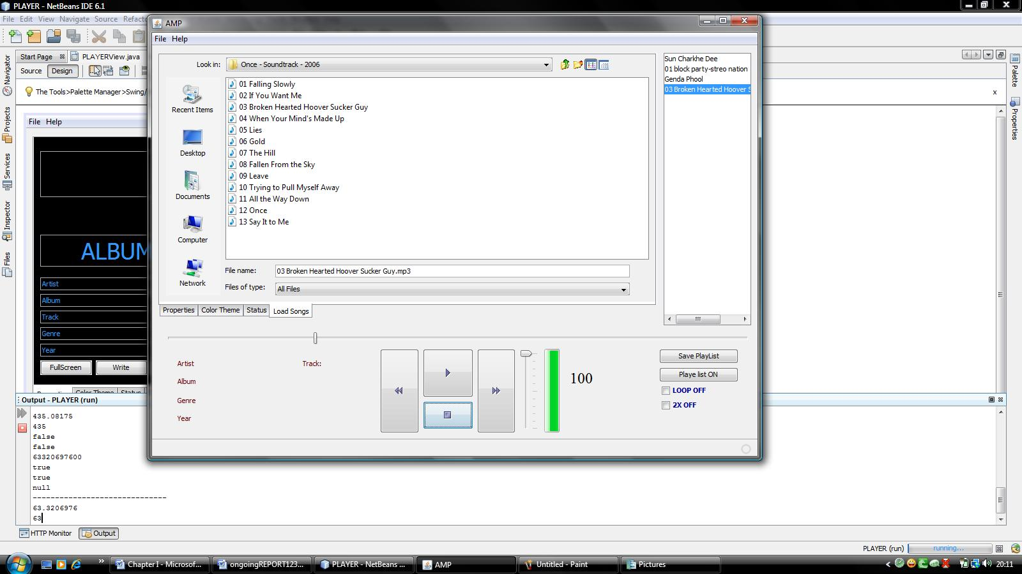
Load Song Panel

Slide 31
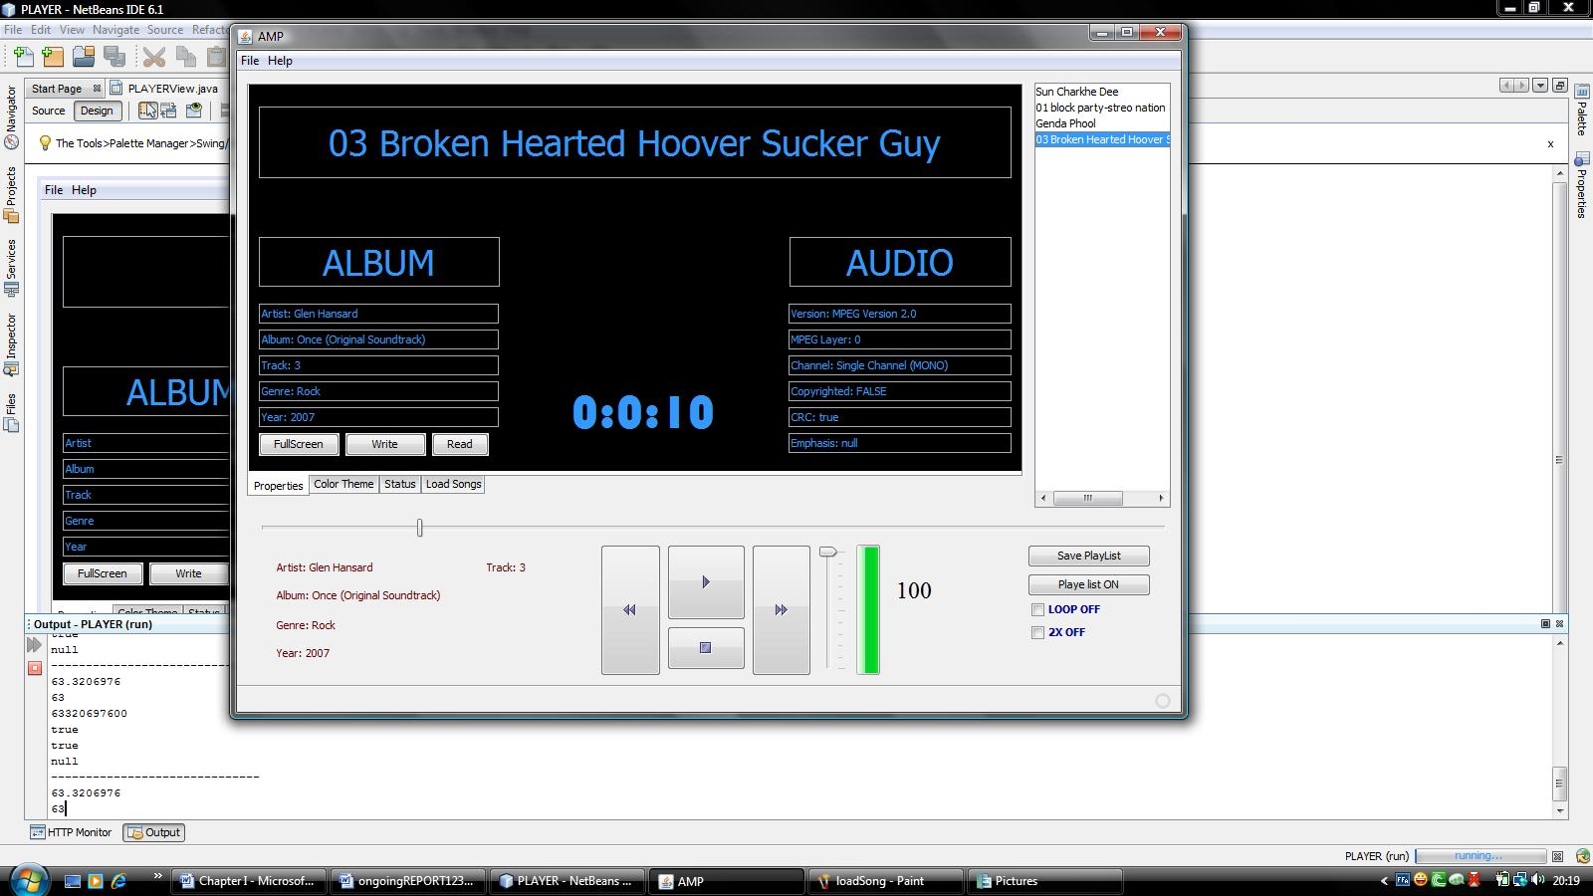
Song Property Panel

Slide 32
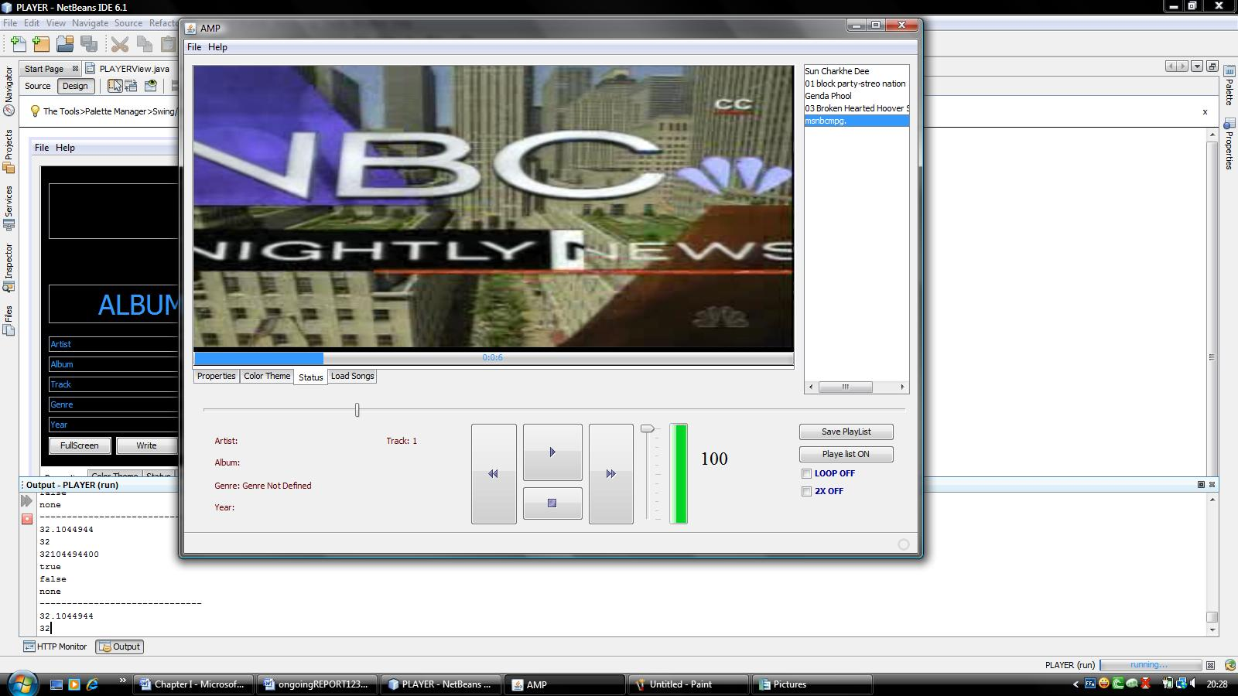
Status & Video Panel

Slide 33
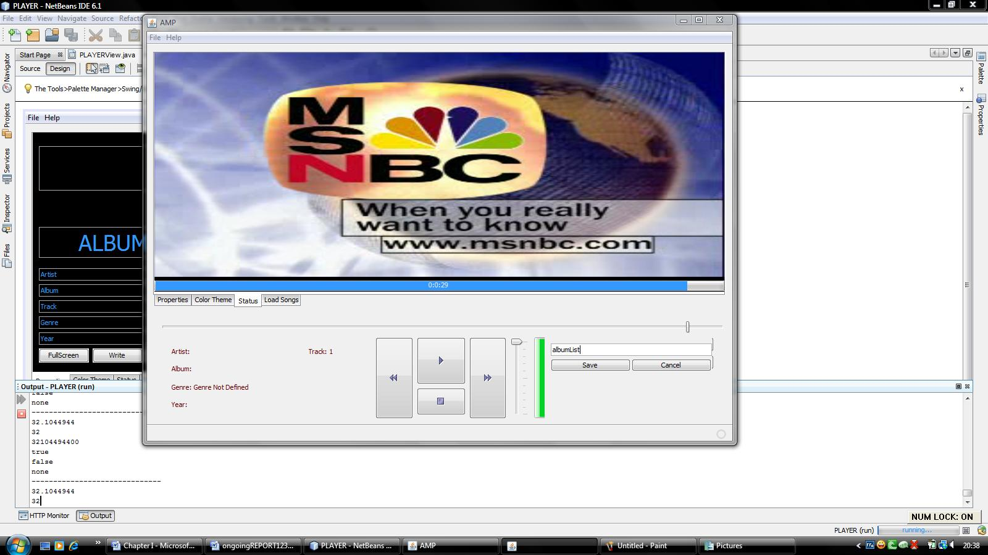
Save Playlist panel window

Slide 34
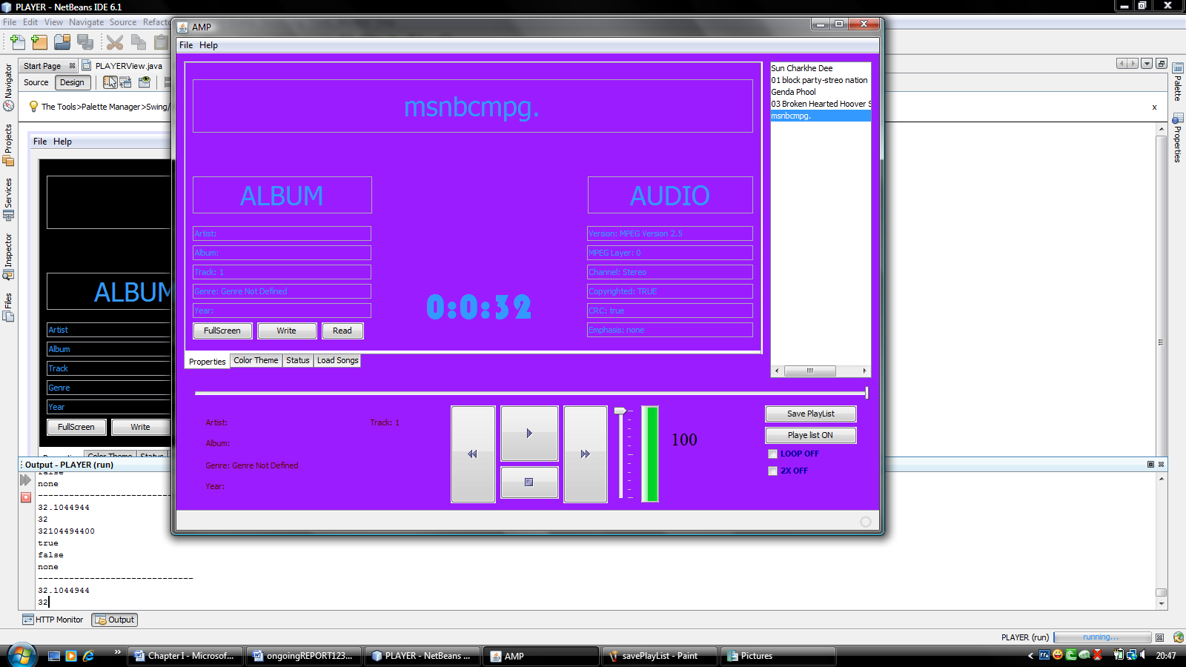
Color Theme Creation Panel

Slide 35
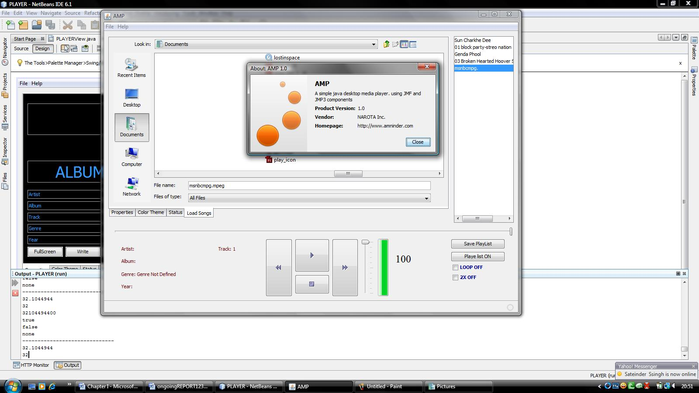
The “About Box”

Slide 36

Full Screen Window

